Slide 1
Banking marketing Campaign Using EDA
By Pranith.G

Slide 2
Dataset Features Overview
💰 Financial Information
Balance – Account balance
Housing – Housing loan status
Loan – Personal loan status
🏦 Customer Information
Age – Age of the customer
Job – Type of occupation
Marital – Marital status
Education – Education level
📞 Campaign Information
Contact – Type of communication
Month – Last contact month
Campaign – Number of contacts performed
Previous – Contacts before this campaign
Poutcome – Previous campaign

Slide 4
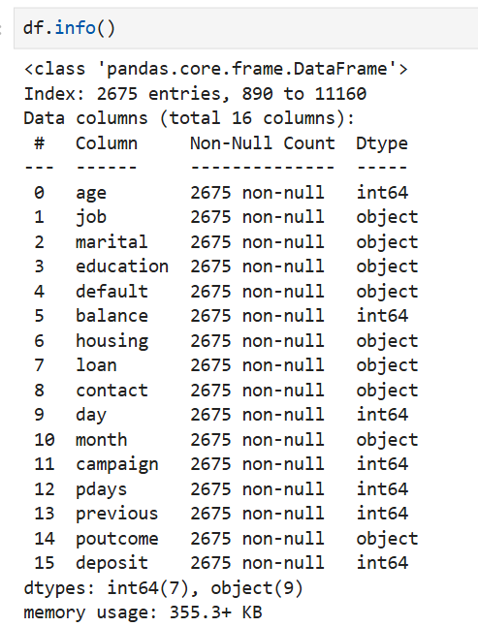
Dataset Overview
Source
UCI Machine Learning Repository
Kaggle – Bank Marketing Dataset
Dataset Details
Total Records: 11,162 (or your sampled 200)
Total Features: 17 input features
Target Variable: Deposit (Yes/No)

Slide 5
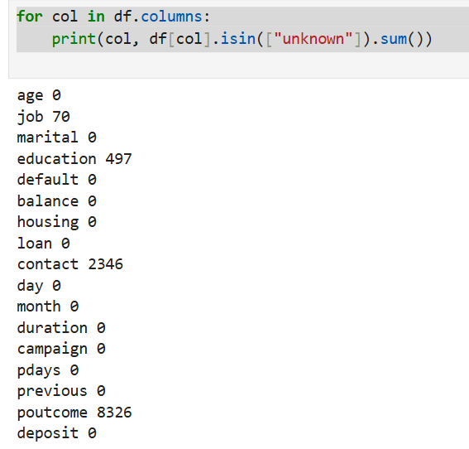
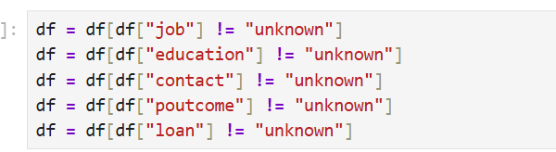
Data Cleaning
Write: Removed unknown values

Slide 6

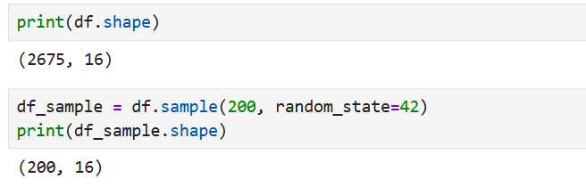
Data cleaning
Sampled 200 rows

Slide 7
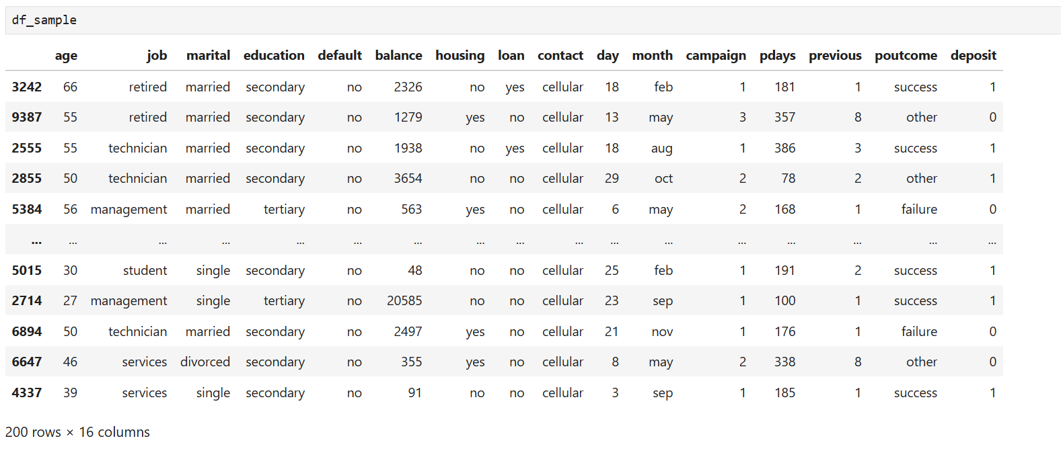

Slide 8
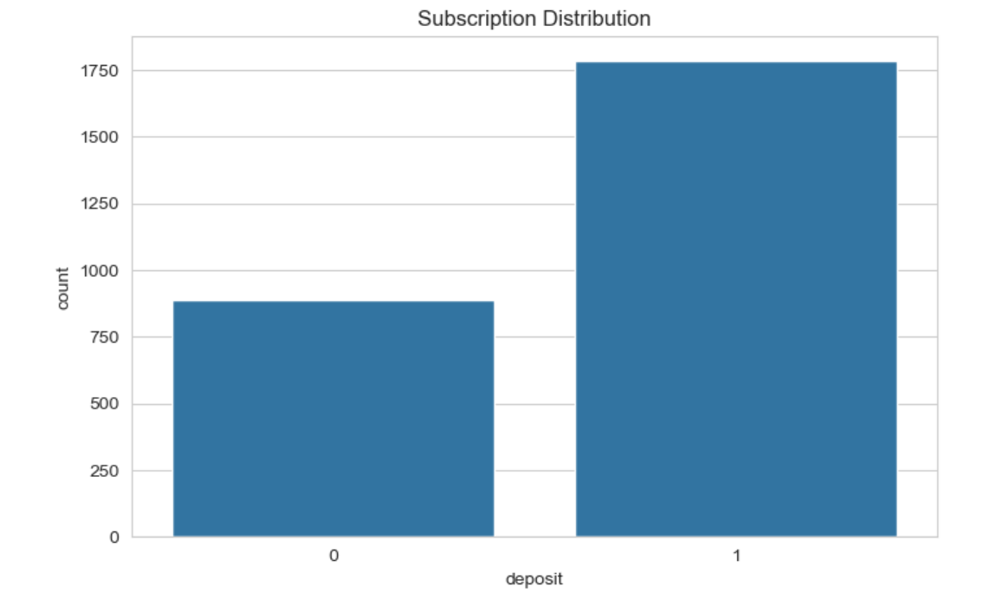
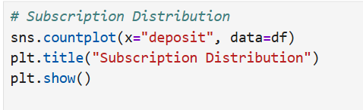
Target Distribution

Slide 9
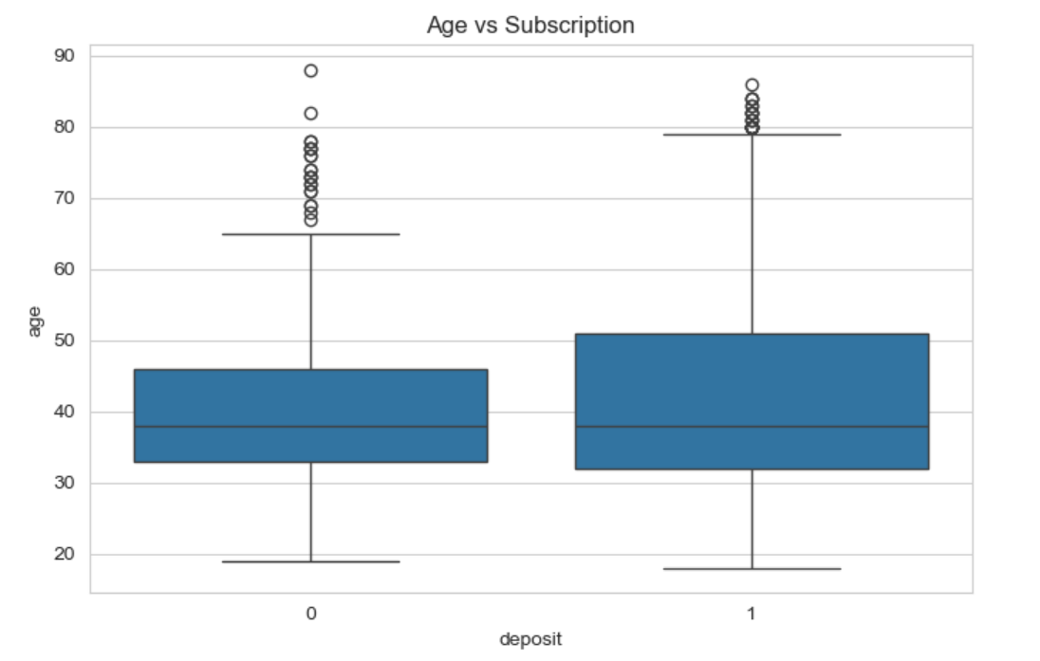
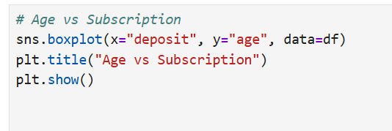
Age vs Subscription

Slide 10
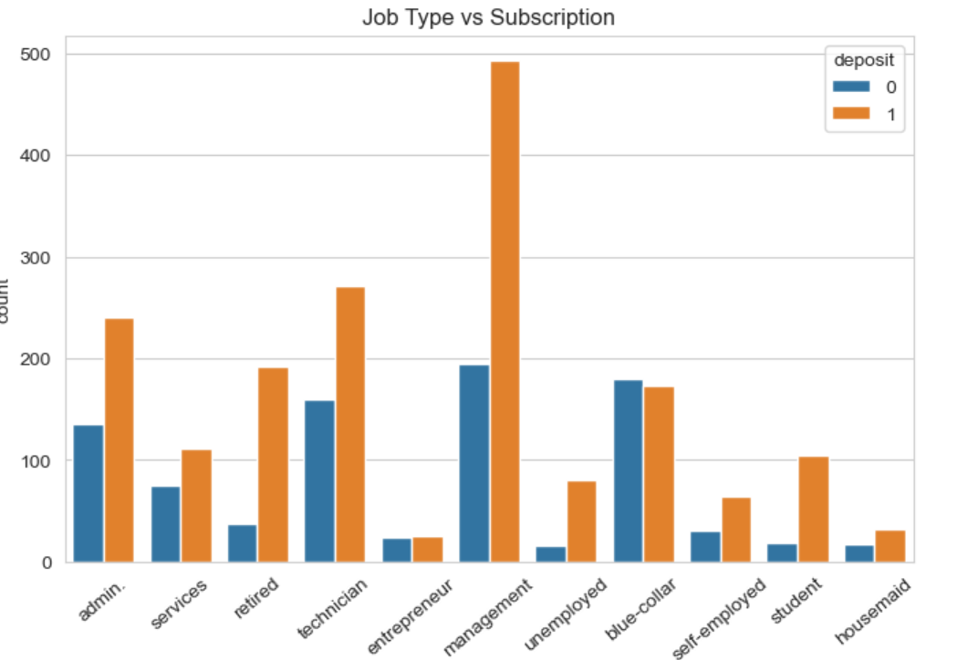
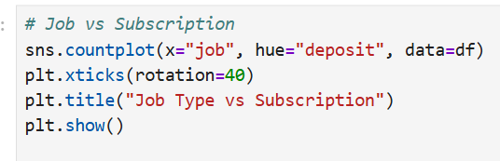
Job vs Subscription

Slide 11
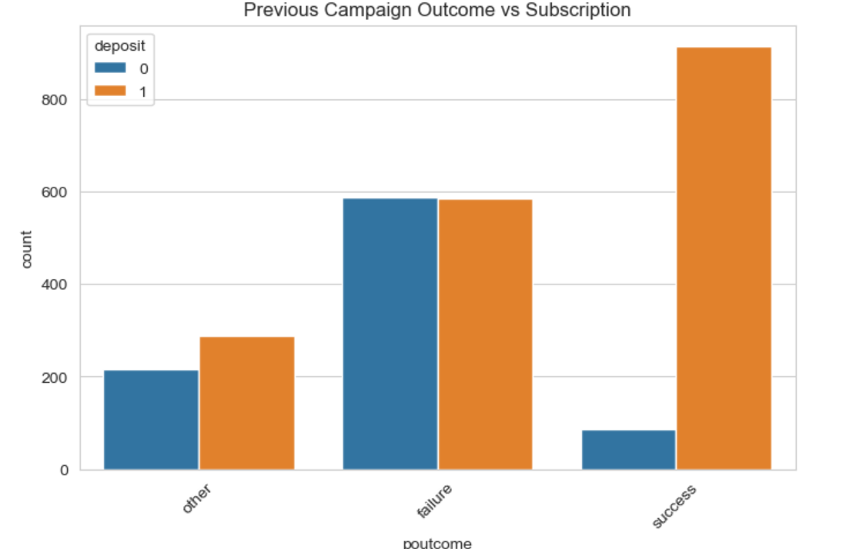
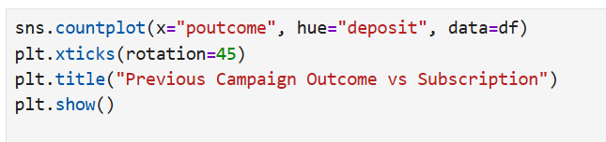
Previous Outcome vs Subscription

Slide 12
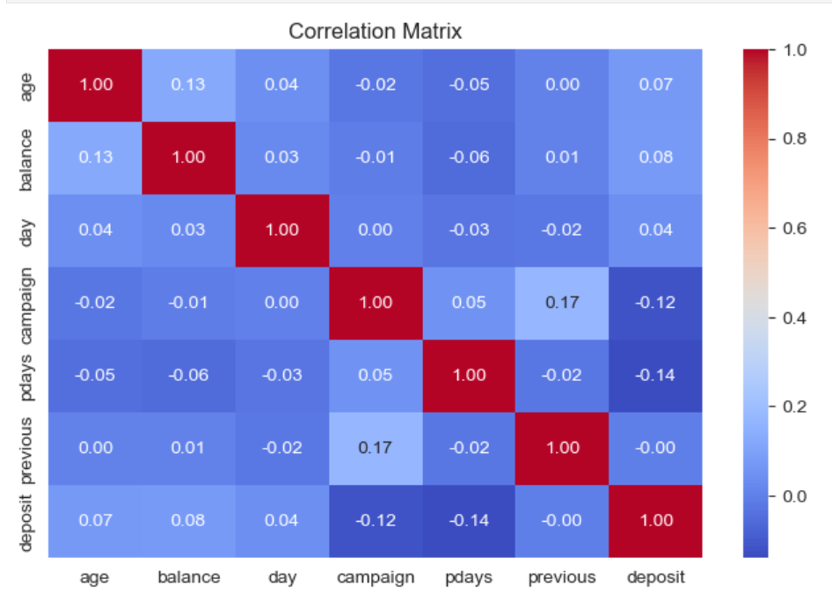
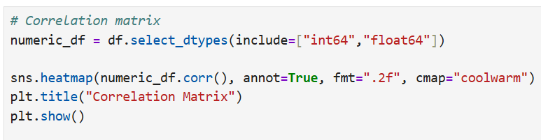
Correlation Heatmap

Slide 13

Pair plot

Slide 14
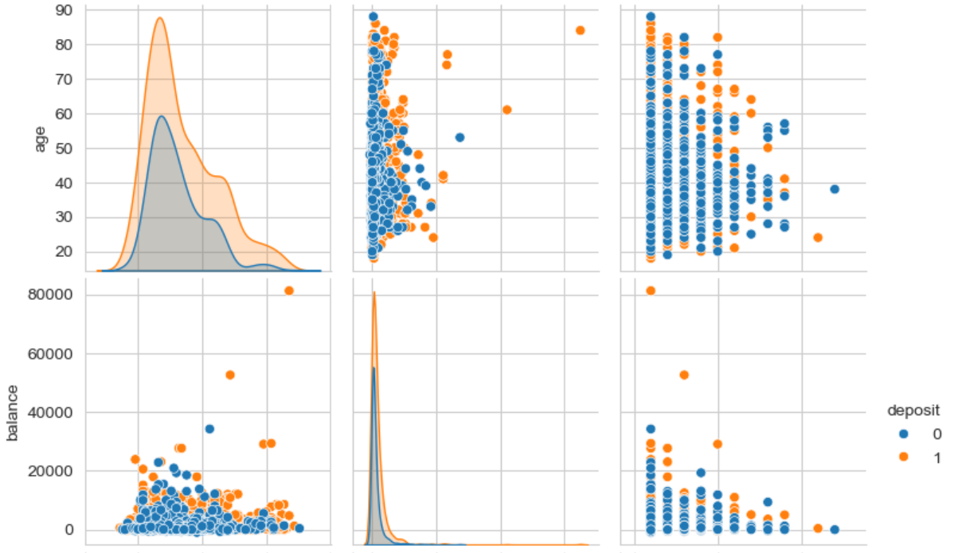
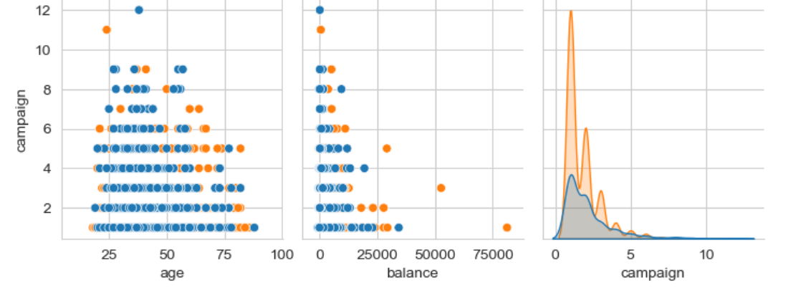

Slide 15
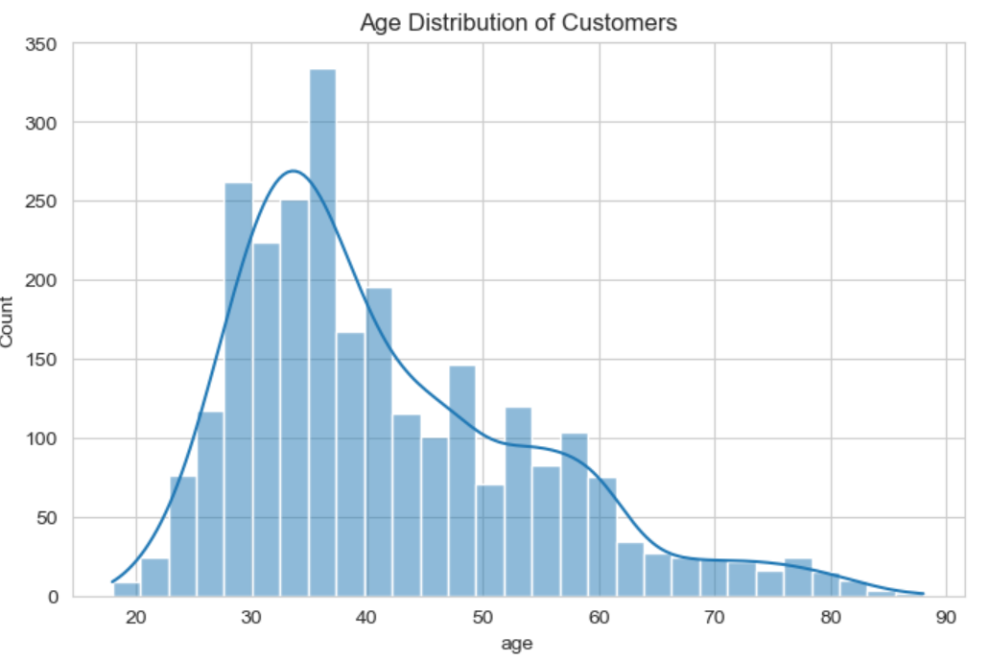
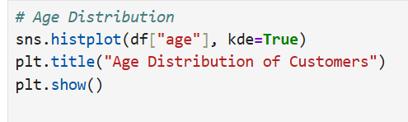
Age Distribution

Slide 16
THANK YOU

